Slide 1
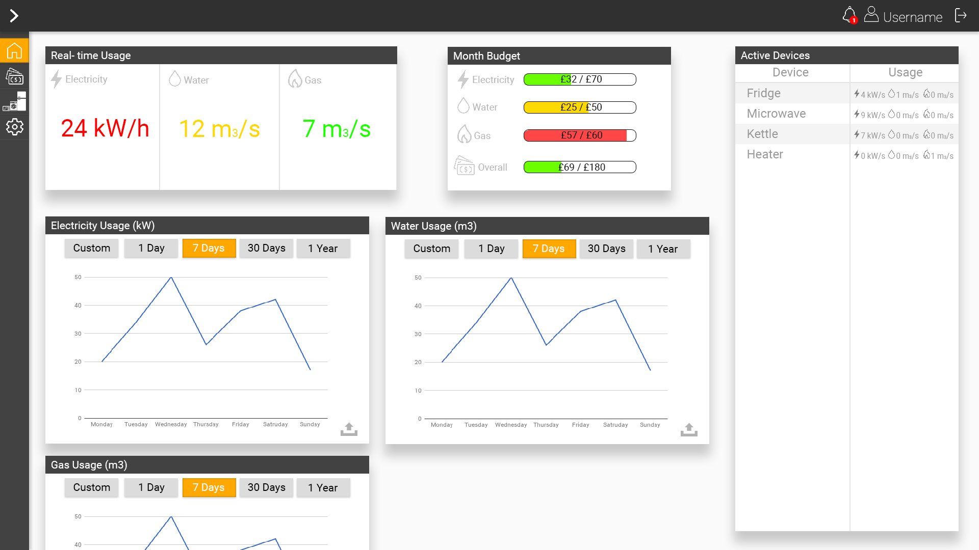
Notes:
Real time usage panel – Shows real time usage of the network. Usage meters are color coded to show high (red),medium (yellow) and small (green) usage.
Month budget panel – shows current month budget spending. It’s color coded as well to show how close to budget limit current spending’s are.
Electrcity/water/gas usage panels – shows graphs of usage in selected period of time.
Active devices – shows currently active devices on the network and theirs usage.

Slide 2
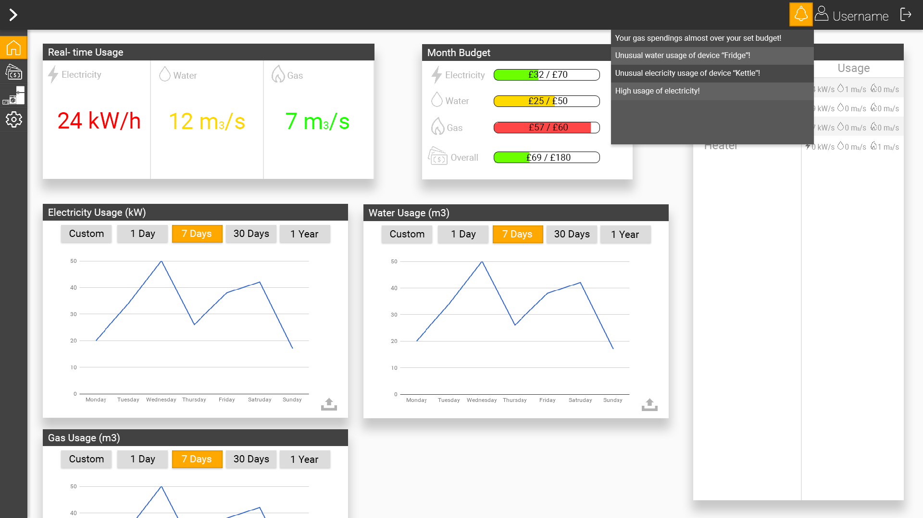
Notes:
By clicking notification bell, all notifications about budget spending’s or usage of devices are shown, these notifications can be enabled or disabled in the settings.

Slide 3
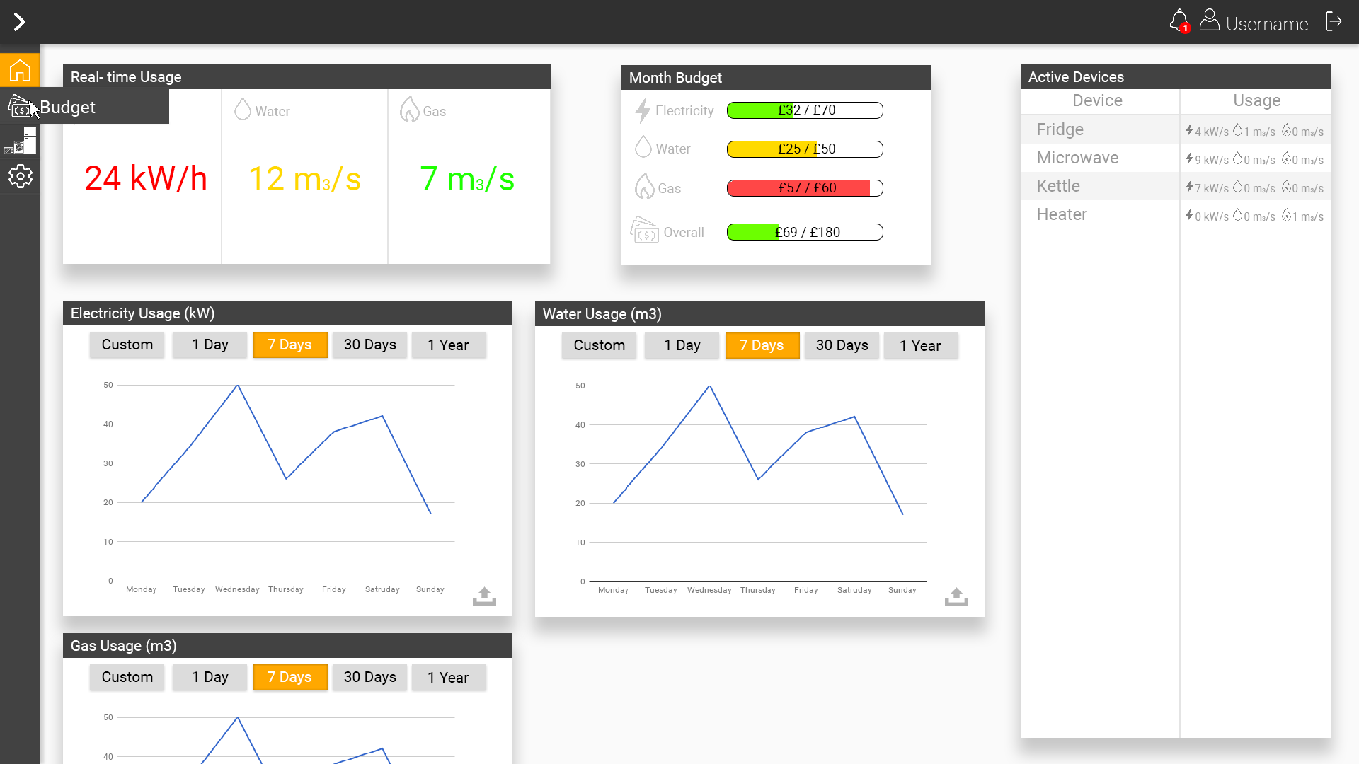
Notes:
When mouse pointer is over the icon in the notification it extends the selection to show the name of the page.

Slide 4
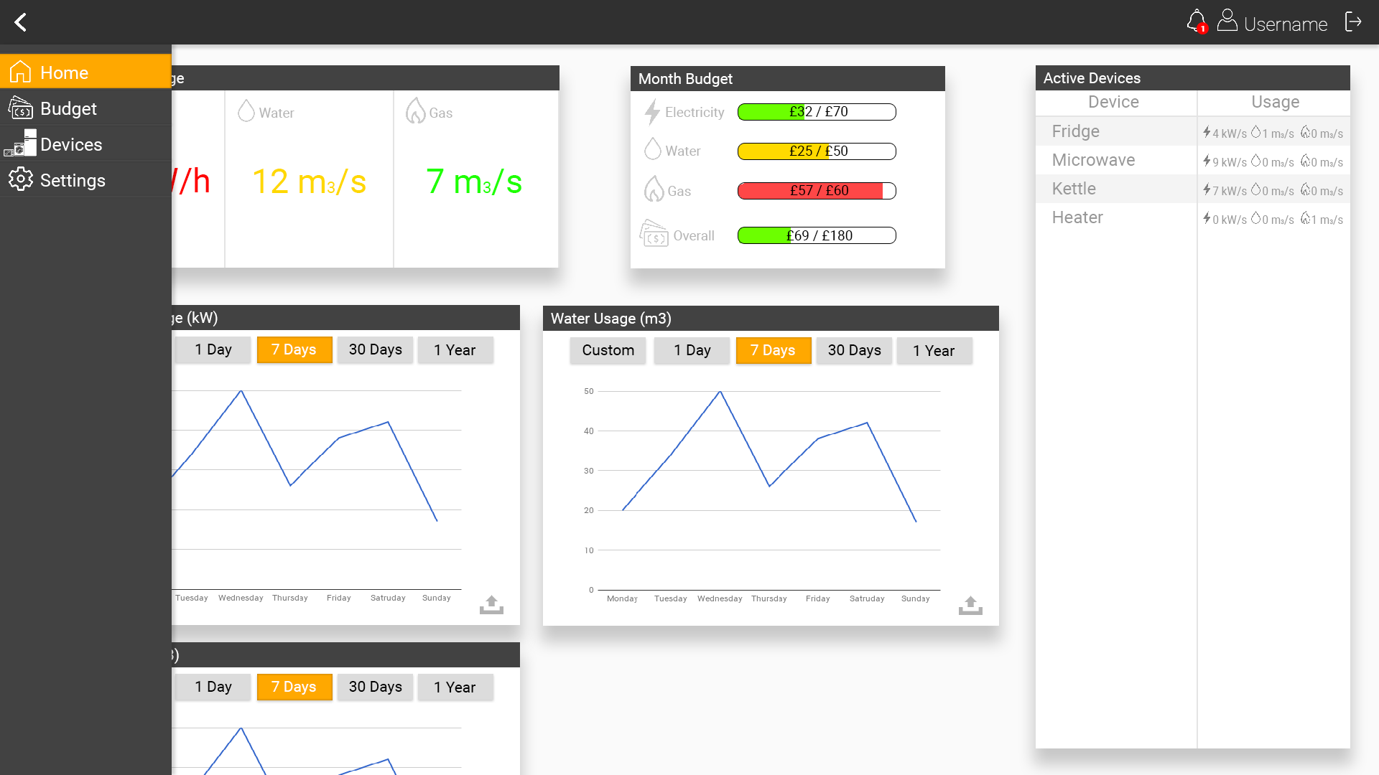
Notes:
Navigation can be extended by user to show all navigation items. By default it is not extended to save usable space in the website.

Slide 5
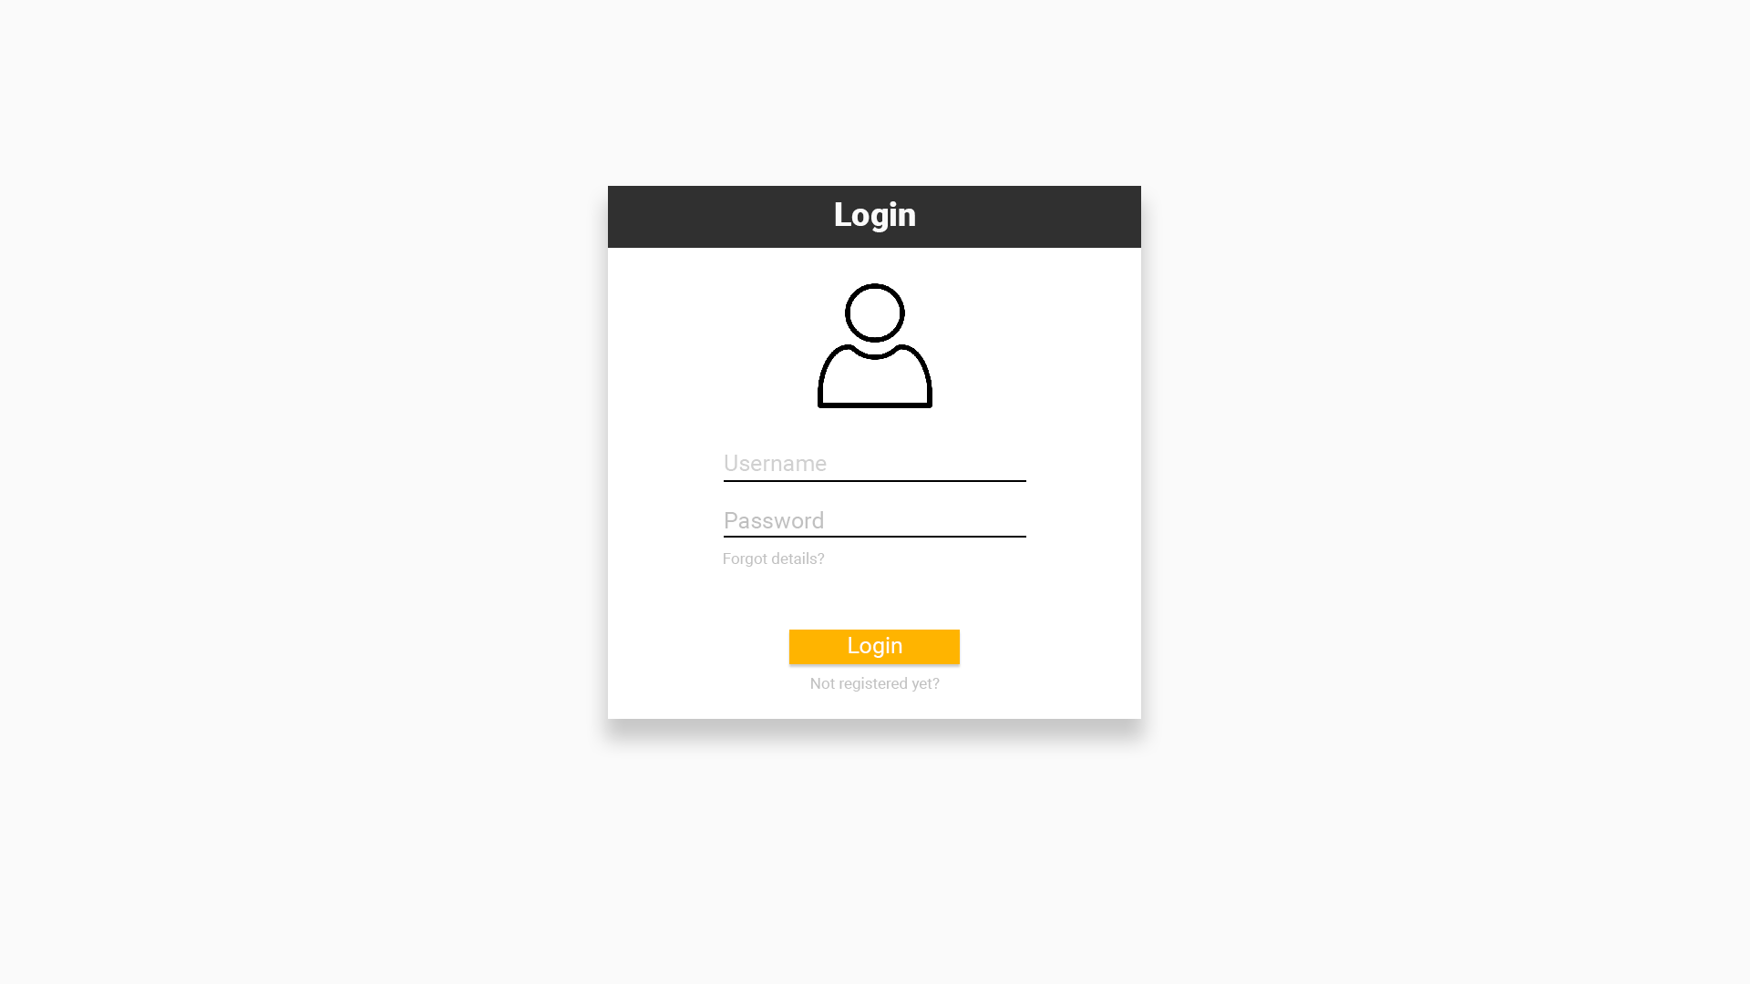
Notes:
Login page only consists of form user fills to log in. links to registration and forgot password shown as well.

Slide 6
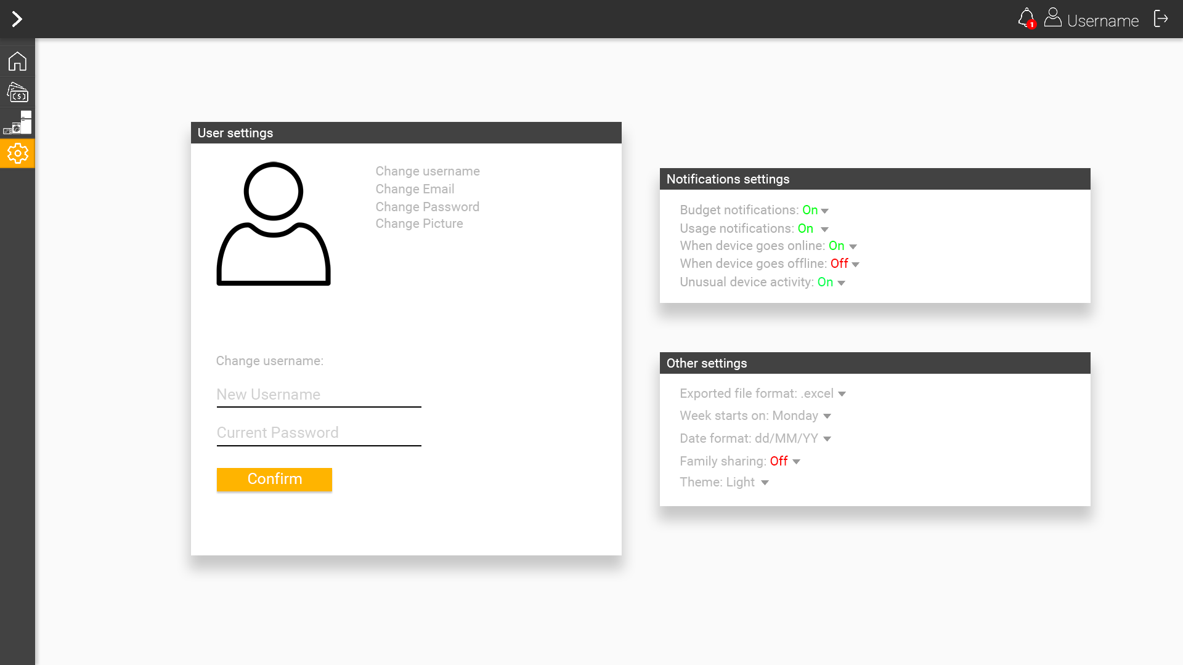
Notes:
Settings page is split into 3 panels. Notifications settings, other settings and user settings. In user settings user is able to change its username, email, password and picture. All changes must be confirmed by typing current user password. Notifications settings allows user to select what kind of notifications should be shown. Available notifications are: budget notifications that shows if budget spending’s are almost or over the set budget for the month. Usage notifications alerts user if current electricity/water/gas usage is very high. When device goes online or offline alerts user if the device started using electricity/water/gas. Unusual device activity alerts user if device started to use more electricity/water/gas than usual.. In other settings user can select various things. Like exported file format for reports, week starting day, date format, family sharing whitch allows other family members to log in and see usage without sharing users password. Theme of the website.

Slide 7
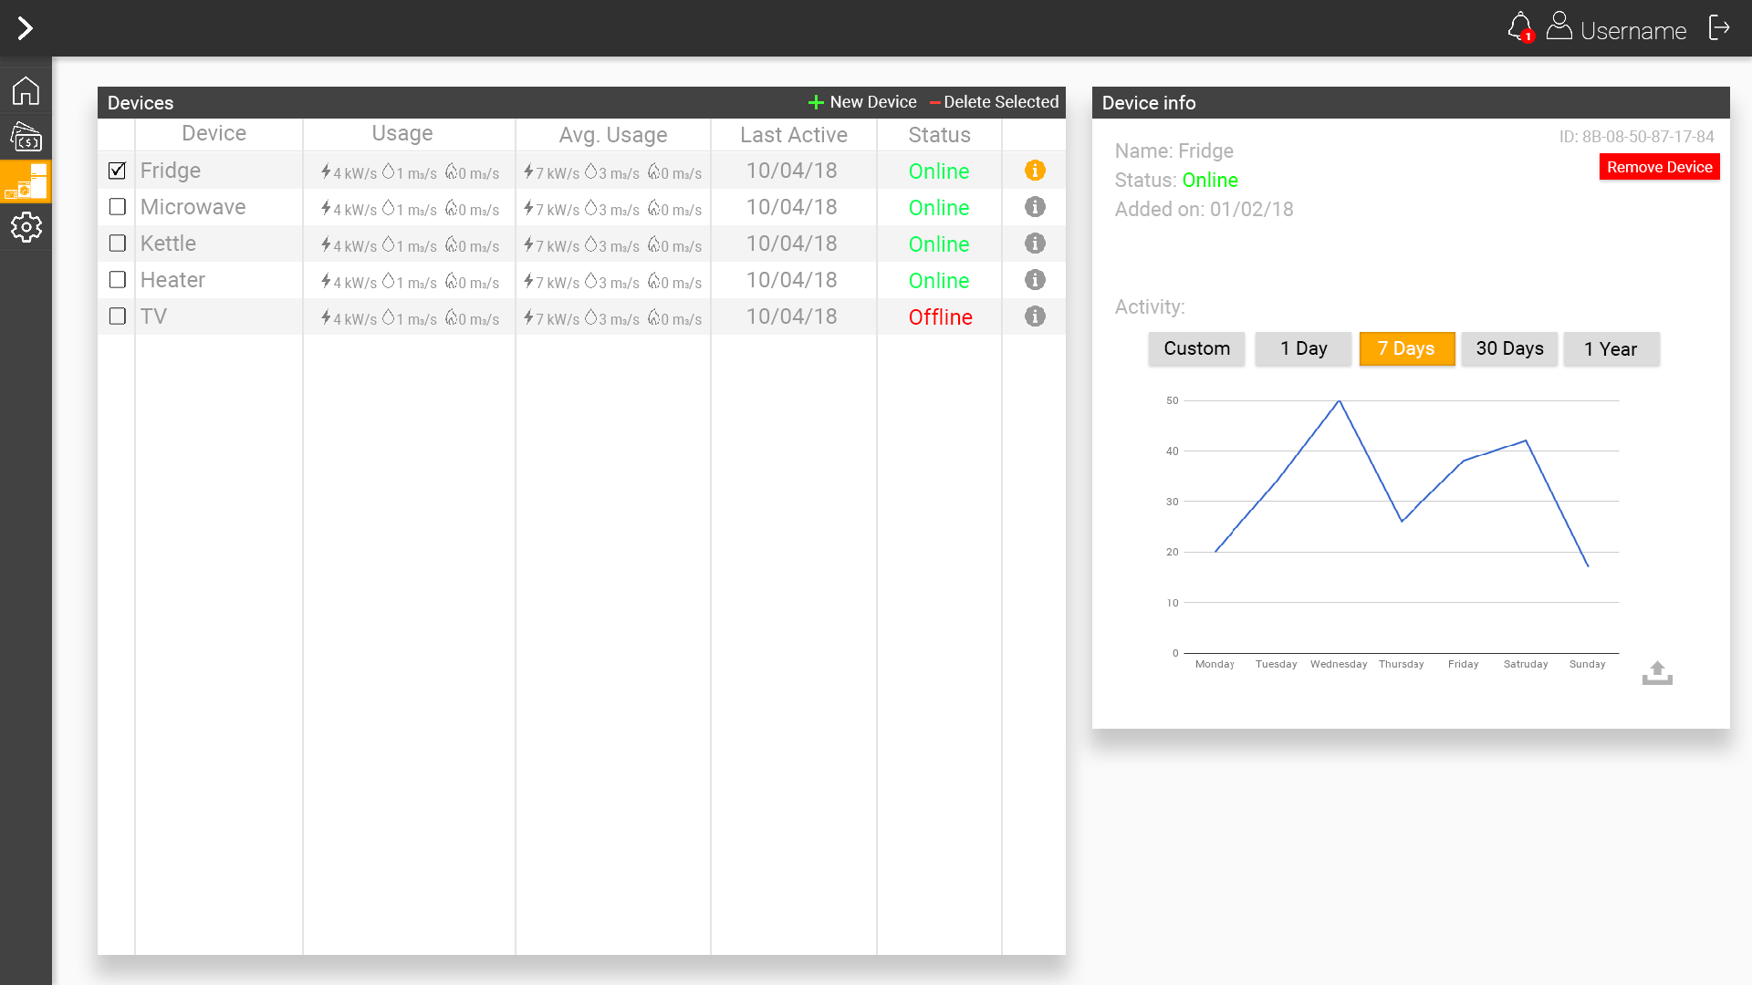
Notes:
In the devices page user can manage and see all the devices on the network and information about selected device. In the device information user can see device usage graph in selected time period, status of the device, when the device was added, device ID.

Slide 8
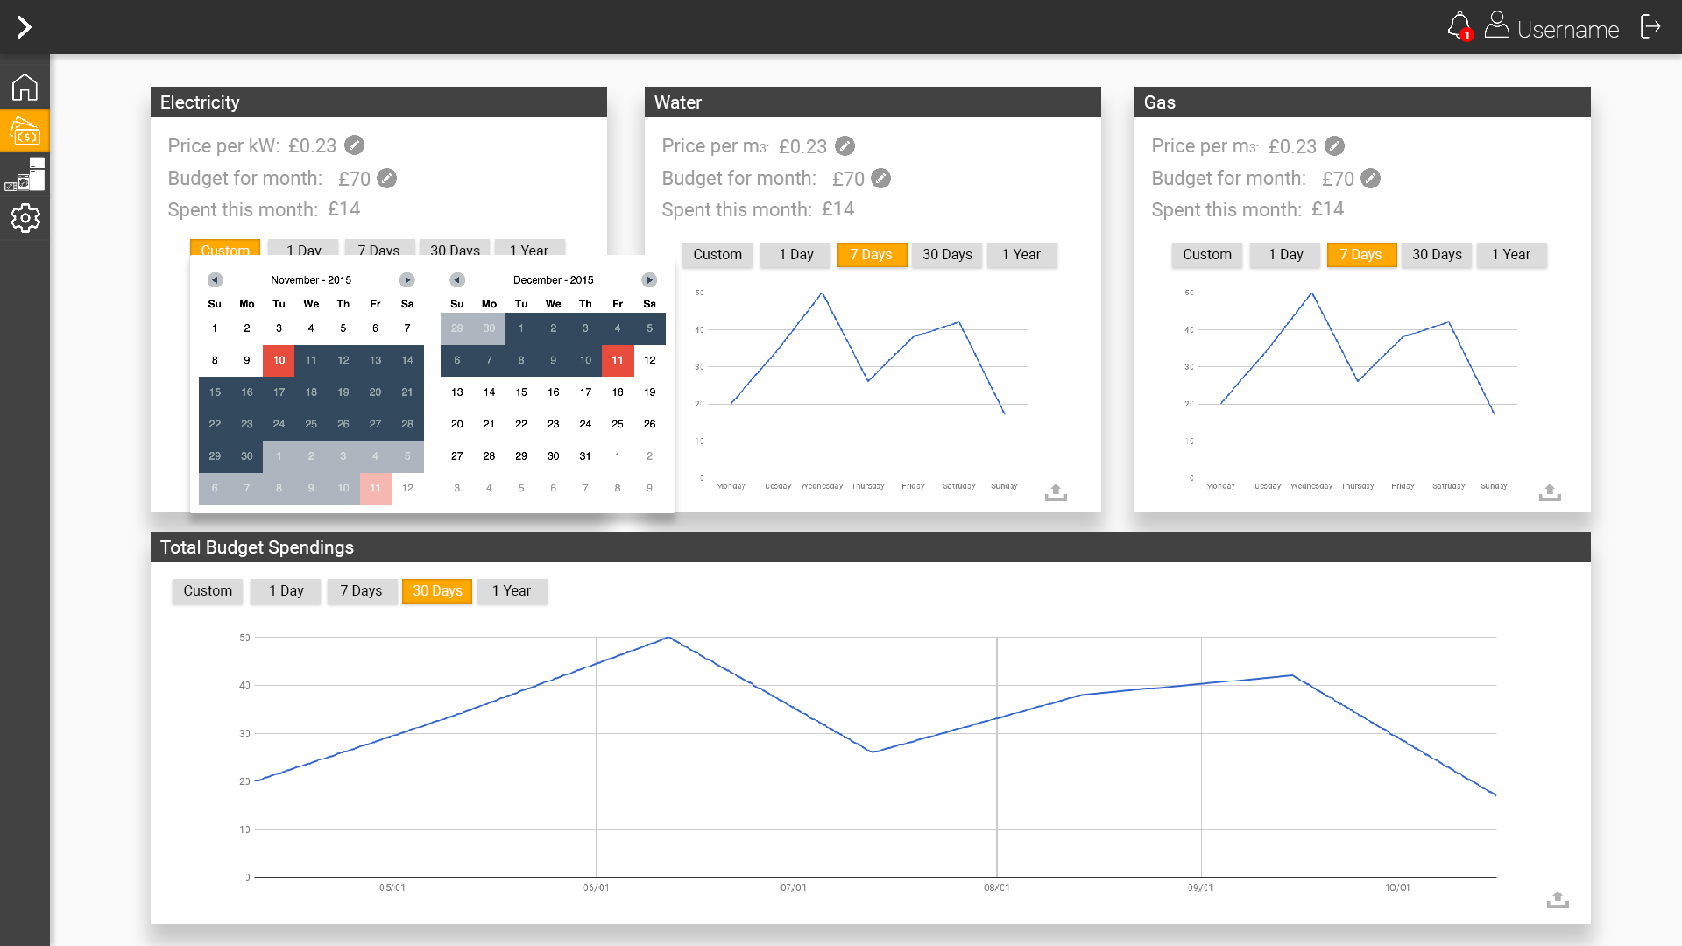
Notes:
In budgets page user is able to edit his budget goals and see how much he spends per selected time period.

Slide 9
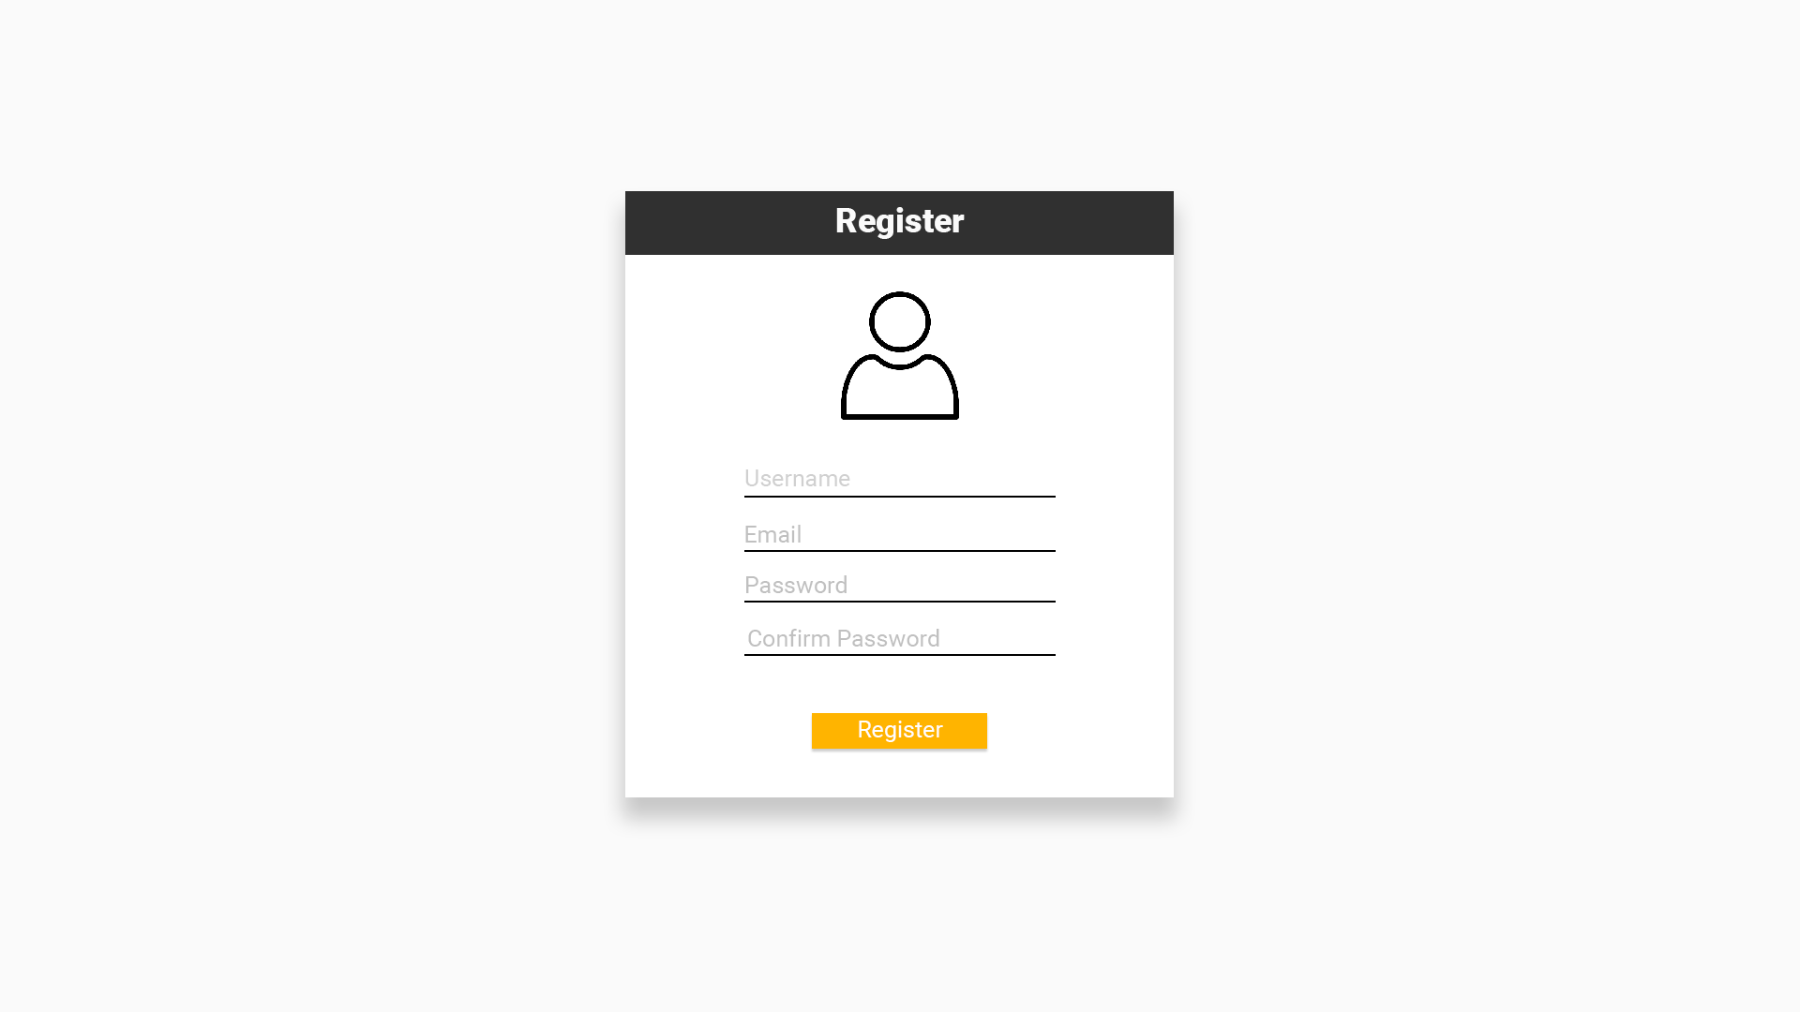
Notes:
Register page consists only of the form to register new user.

